Slide 1
Sudoku Project Architecture
By Mei Singer, Marianna Natale, Fabio Amado, Kyle Karr, Viet Nguyen

Slide 2
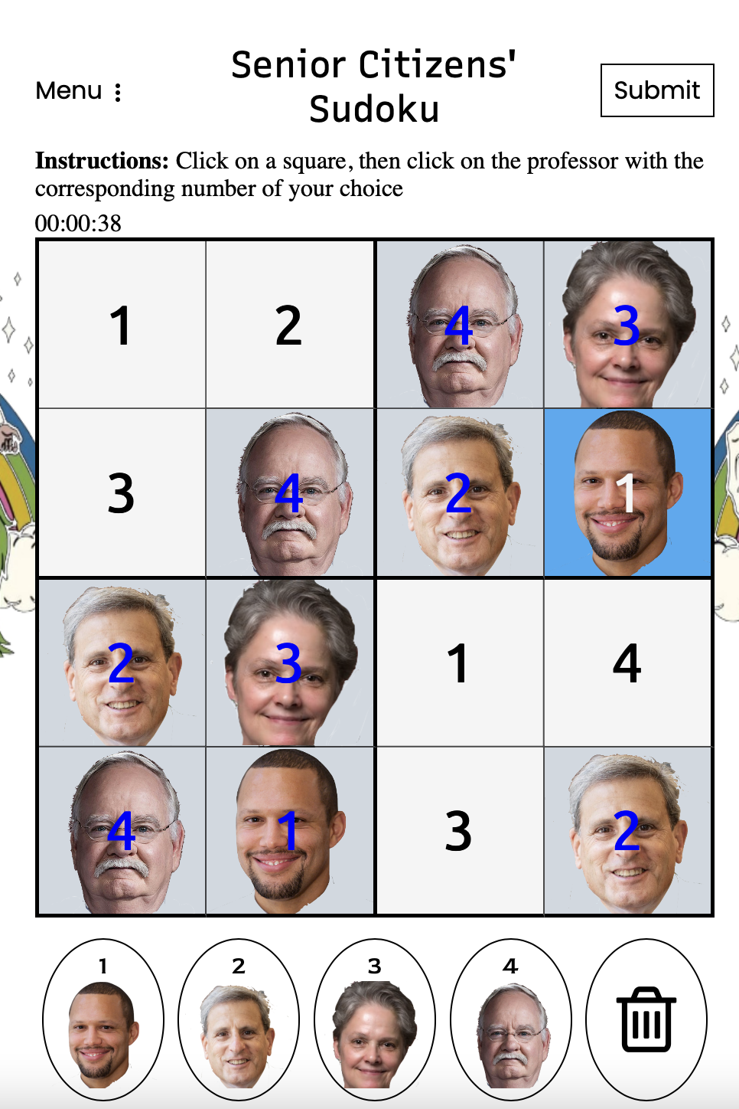
Intro
Our Project focuses on creating a sudoku game with images set up as the numbers and a timer to record the time it takes the user to complete the boards.

Slide 3
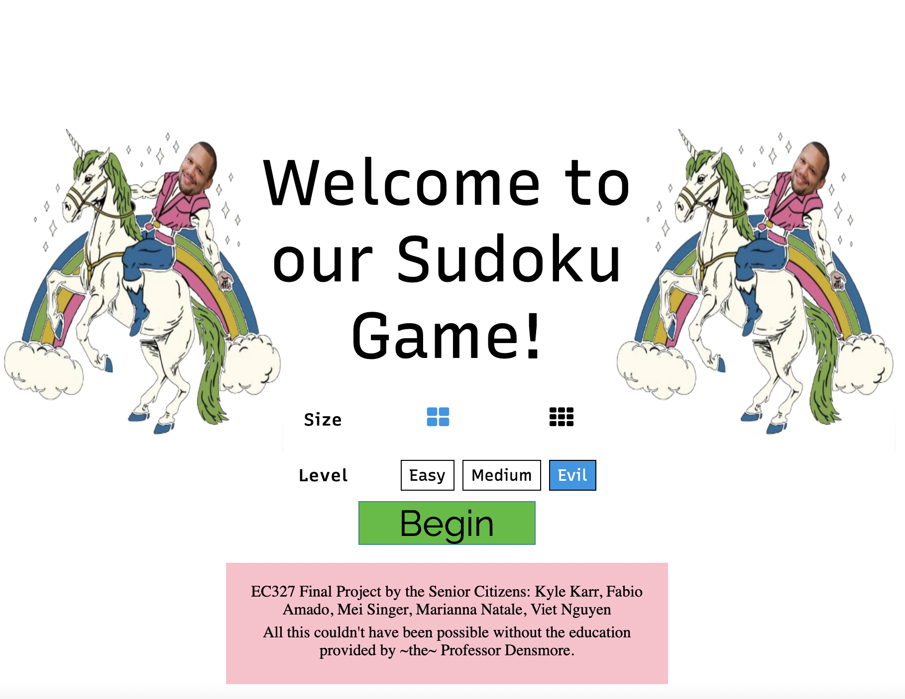
Home Screen Features
Header
Welcome to our Sudoku Game!
Size Selection
4x4
9x9
Level/Difficulty Selection
Easy
Medium
Difficult
Start Button
Footer

Slide 4
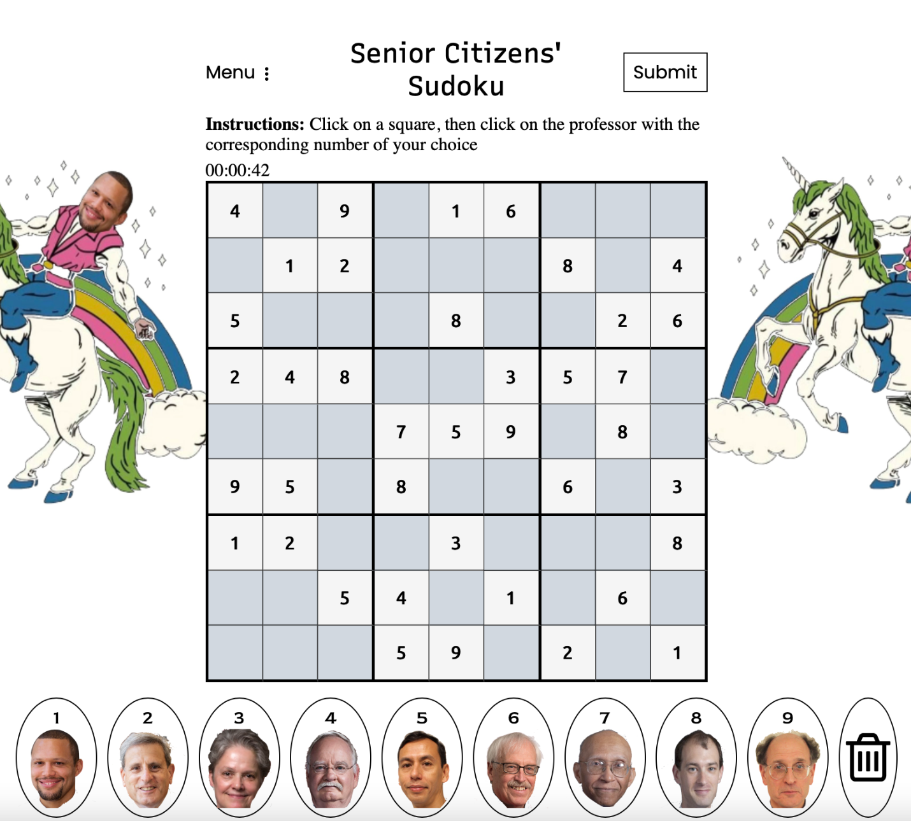
Game Screen Features
Menu Dots Button
Header
Submit Button
Instructions text
Timer
Board
Given squares: set
Blank squares: user input by click and selecting desired input on keypad
Keypad with Input Buttons
Delete Button
Functions by clicking on square and clicking on trash can

Slide 5
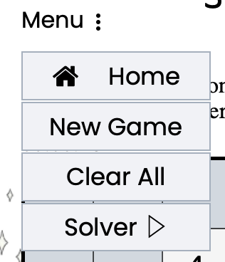
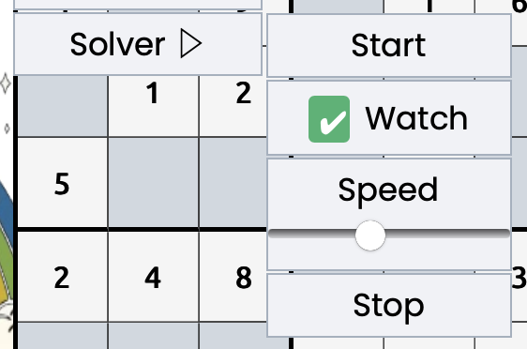
Menu
Drop Down Dot Menu Button
Home Button
Ends game and goes back to home screen
New Game Button
Prompts alert pop up, to confirm that the user would like to end the current game
Clears board and timer, starts a new game with a new board if confirmed
Clear All Button
Prompts alert pop up, to confirm that the user would like to clear all inputs
Clears all user inputs if confirmed
Solver Button
Start button prompts the program to solve the board
Watch button allows user to watch the solving
Speed dial adjusts the speed at which the board is solved
Stop button terminates the program solving

Slide 6
Thanks!

